Slide 1
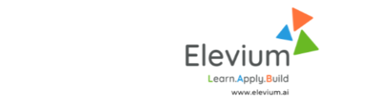
NANOCHIP MINI PROJECT
IoT system integration & SV for RTL Verification
Design and Implementation of a Cloud-Connected
Real-Time Smart Irrigation with Soil-Stress Detection

Slide 2
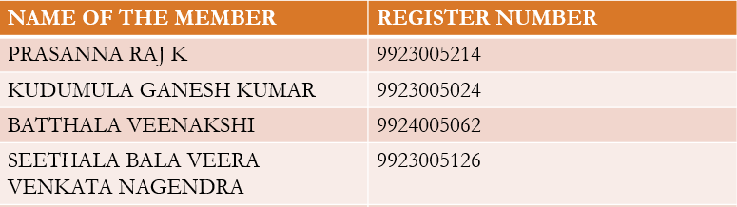
Design and Implementation of a Cloud-Connected
Real-Time Smart Irrigation with Soil-Stress Detection
TEAM-11

Slide 3
PROBLEM STATEMENT
Traditional irrigation systems rely on manual scheduling and fixed watering intervals, leading to water wastage and inefficient crop growth.
Due to changing soil conditions and climate variations, farmers lack real-time data on soil moisture and plant stress levels, causing over-irrigation or under-irrigation.
Hence, there is a need for a real-time, intelligent irrigation system that detects soil stress and automatically controls water flow based on actual field conditions using IoT and cloud analytics.

Slide 4
OBJECTIVES
  To design a smart irrigation system that automatically controls valves based on soil stress conditions.
To achieve real-time monitoring of soil parameters such as moisture, temperature, and humidity using ESP32 and LoRa communication.
To implement edge-based threshold logic for local decision-making with a 1–5 second latency for critical responses.
To integrate cloud connectivity for data storage, visualization, and advanced analytics.
To enable secure OTA (Over-the-Air) firmware updates for remote system maintenance.

Slide 5
Automatic irrigation tasks to reduce manual labour, especially in large-scale farming or landscape maintenance.
Promote eco-friendly practices by reducing water runoff, minimizing erosion, and conserving water resources.
Automatic irrigation system to optimize energy use, avoiding unnecessary pumping and minimizing power consumption.
Ensuring plants, crops, or landscapes that receives optimal water for growth, improving yields and maintaining plant health.
Main Objective : The main goal for irrigation is “ to provide plants with proper amount of water at the best time” .

Slide 6
LITERATURE REVIEW/BACKGROUND
Several IoT-based irrigation systems have been developed to automate water supply, primarily using Wi-Fi or GSM networks. However, these approaches face challenges such as limited range, high latency, and network dependency.
Recent studies highlight the importance of edge computing and LoRa networks for agricultural IoT applications due to their low power consumption and wide coverage.
Existing works often focus on soil moisture sensing alone, but few integrate real-time soil-stress analysis, edge decision-making, and cloud-based intelligence together for scalable deployment.
This project addresses these gaps by combining ESP32-LoRa edge nodes, cloud analytics, and secure communication to achieve efficient, data-driven irrigation.

Slide 7
Expected Outcome
A working prototype of a smart irrigation system capable of automatic soil-stress detection and water control.
Dashboard interface for real-time monitoring and analytics.
Reduced water usage through intelligent decision-making.
Secure and scalable IoT network using LoRa and cloud technologies.

Slide 8
Proposed Methodology
Hardware Setup:
Use ESP32 microcontroller as edge node integrated with soil moisture, temperature, and humidity sensors.
Deploy LoRa modules for long-range, low-power data transmission.
Edge Processing:
Implement threshold-based decision logic for real-time actuation.
Cloud Integration:
Send sensor data to a cloud platform (e.g., AWS IoT, ThingSpeak, or Firebase) via LoRa gateway.

Slide 9
Enable data analytics and visualization dashboards.
Trigger irrigation valves automatically when soil moisture drops below preset levels.
Secure OTA Updates:
Provide firmware update functionality remotely through a secure OTA mechanism.
Testing & Optimization
Measure latency, water efficiency, and reliability under various field conditions.

Slide 10
APPLICATIONS/SCOPE
Agriculture: Efficient irrigation management for farms and greenhouses.
Horticulture: Smart watering of gardens and landscapes.
Water Conservation: Reduces over-irrigation and promotes sustainable farming.
Scalability: Can be expanded for large-scale smart farming with multiple zones.
Industry Relevance: Supports the development of precision agriculture and IoT-based automation.

Slide 11
RESOURCE REQUIRED
Hardware:
ESP32, LoRa modules (SX1278), Soil Moisture Sensor, DHT11/DHT22 Sensor, Solenoid Valve, Relay Module, Power Supply, Buzzer, Jumper Wires.
Software:
Arduino IDE, ThingSpeak / Firebase / AWS IoT Core, Python for analytics, OTA firmware tools.
Other Requirements:
Internet connectivity, Cloud subscription (free tier), Testing setup (plants or soil beds).

Slide 12
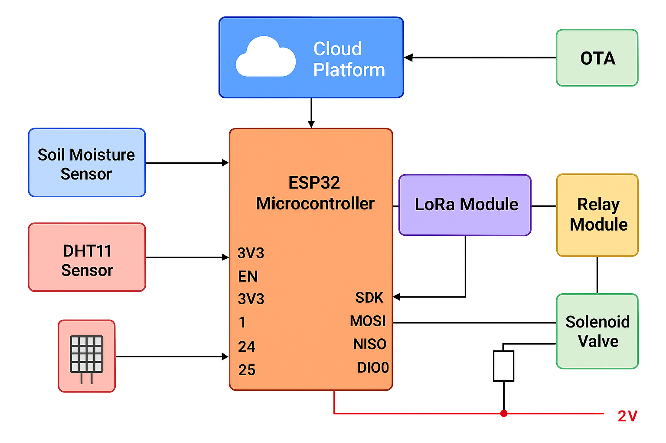
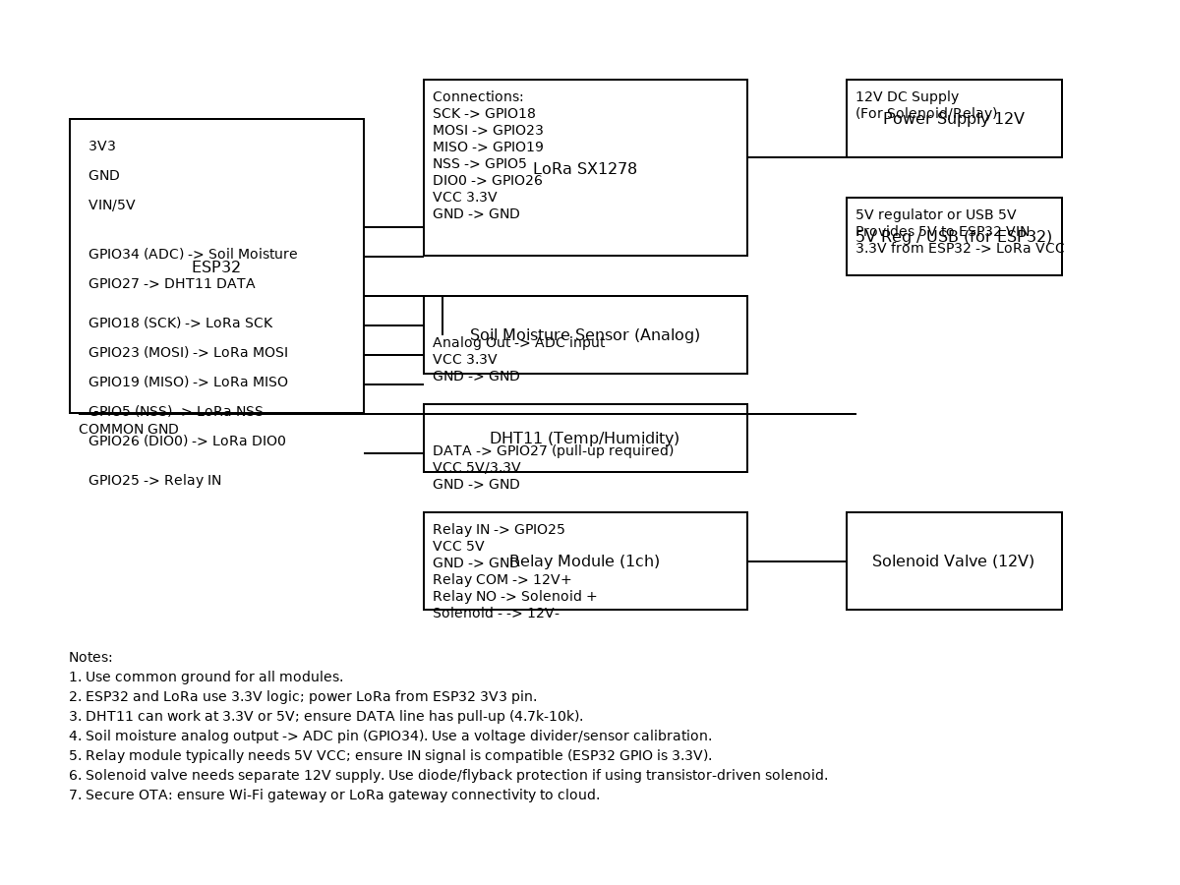
CIRCUIT DIAGRAM

Slide 13
PROJECT TIMELINE
Phase | Description | Duration
Phase 1 | Literature Review & Problem Definition | 1 week
Phase 2 | Hardware Design & Sensor Integration | 2 weeks
Phase 3 | LoRa Communication & Edge Logic Implementation | 2 weeks
Phase 4 | Cloud Integration & OTA Setup | 2 weeks
Phase 5 | Testing, Data Analysis & Final Optimization | 2 weeks
Total Duration | ~9 weeks

Slide 14
REFERENCES
 | Research Paper: “IoT-Based Smart Irrigation System Using LoRa and Cloud Computing,” IEEE Access, 2023. ThingSpeak IoT Cloud Documentation. Espressif Systems – ESP32 Technical Reference Manual. AWS IoT Core Developer Guide. Related GitHub repositories and open-source IoT frameworks for smart agriculture.

Slide 15
THANK YOU

